Slide 1
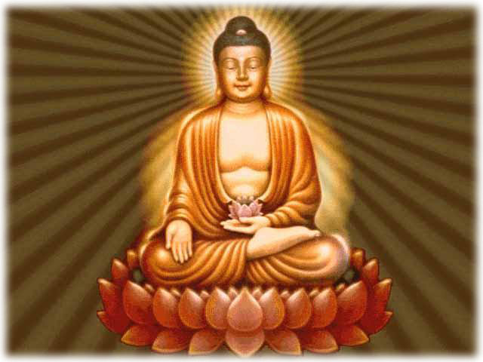
Religions of Asia
How they spread and Modern Influence

Slide 2
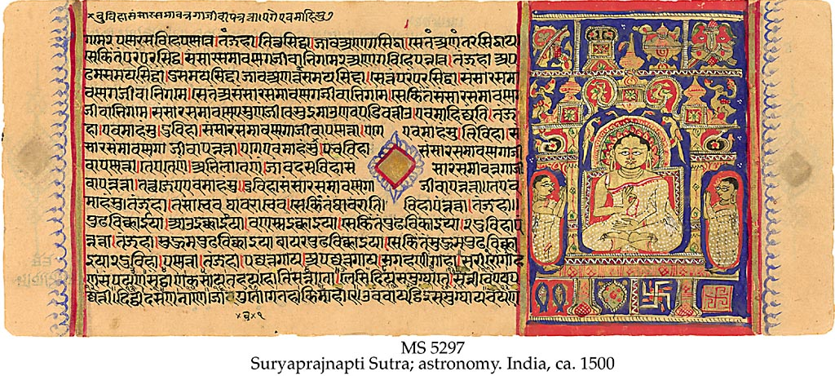
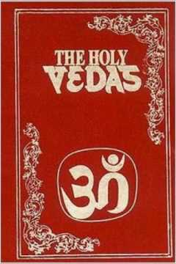
Hinduism Origins
Began about 2,000 B.C.
NO central authority figure (No Pope, Priest, or Rabbi)
NO single founder
Originated from Aryan practices passed down & written in the Vedas
Does not have one central holy book
Vedas: books of knowledge; contains prayers & religious practices
Bhagavad-Gita: spiritual book w/text on how to reach a spiritual life

Slide 3
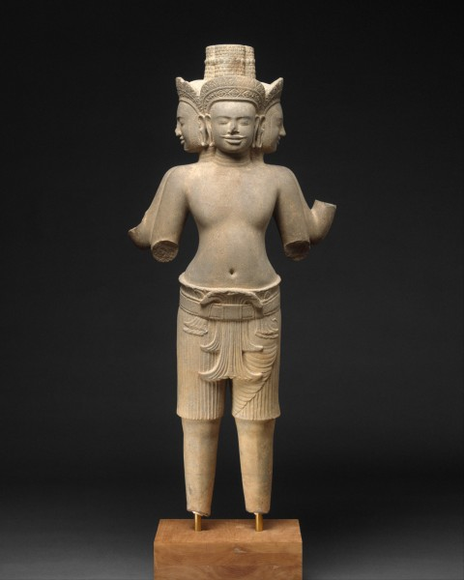
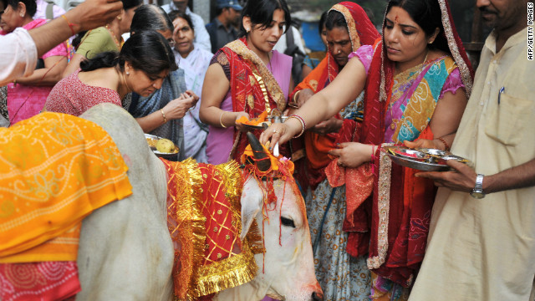
Considered polytheistic, BUT all gods/goddesses are different parts of one SINGLE Supreme Force called Brahman
Major religion of India and Nepal
3rd most popular religion in the world
estimated over 750 million Hindus world wide

Slide 4
India

Slide 5
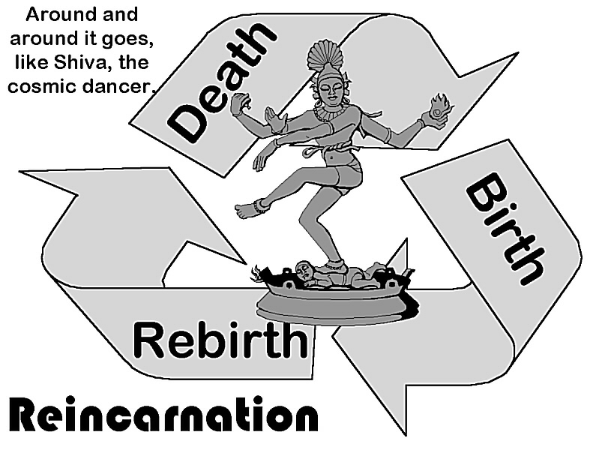
Hinduism Beliefs
Reincarnation: Belief that after the body dies the soul is reborn and continues to be reborn until your soul reaches perfection.
Perfection = when your KARMA is in balance

Slide 6
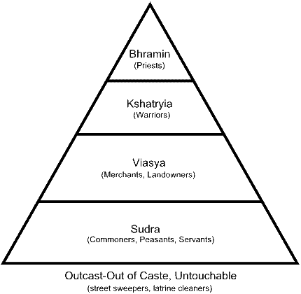
Hinduism Beliefs
Karma:
If you do good things, good things will happen to you
If you do bad things, bad things will happen to you

Slide 7
Hinduism Beliefs
Once your soul is perfect it rejoins Brahma.
This state of perfection is called Moksha
4 paths lead to Moksha but Hindus are open to suggestions for other paths…a.k.a. other religions
Path of Devotion- choose one god/goddess to worship
Path of Action- do good works
Path of Knowledge- spiritual knowledge
Path of Meditation- concentrate to reach inner self

Slide 8
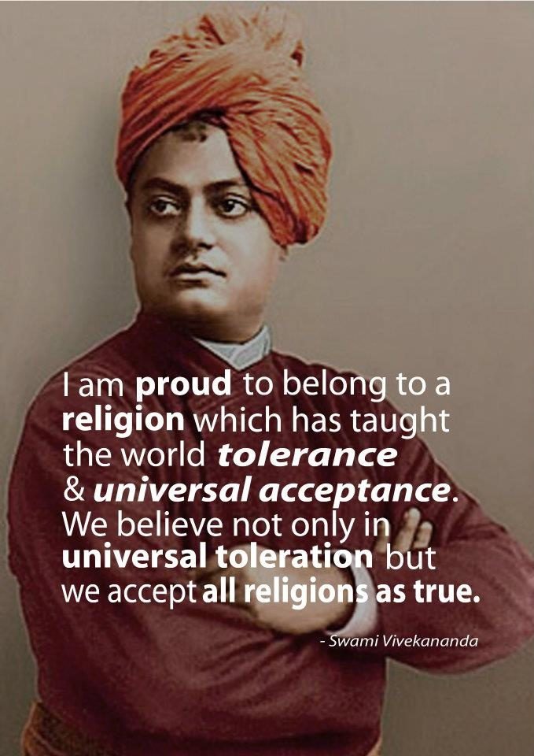
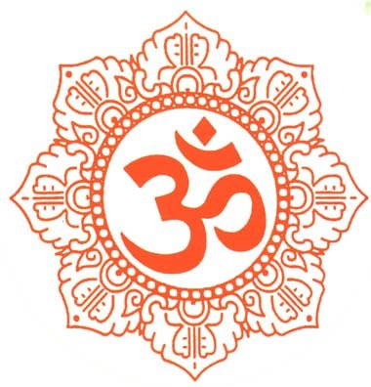
Hindus are tolerant to other religions. They see themes of forgiveness, compassion, tolerance as universal and see other religions as different paths to the same ideas

Slide 9
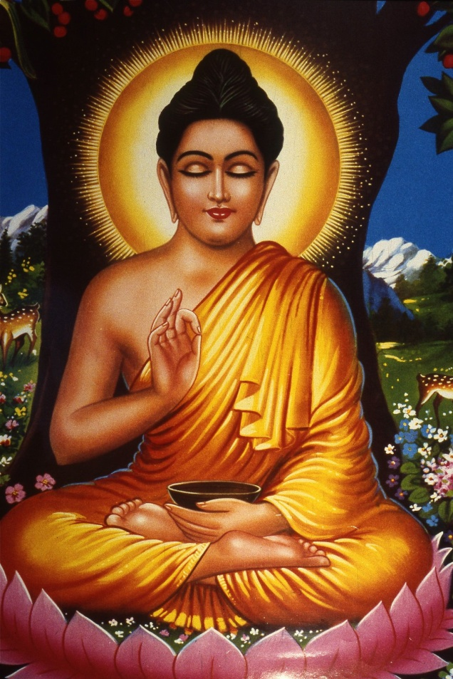
Buddhism
Started in India around 500 BC by a prince named Siddhartha Gautama
Siddhartha was a rich prince who wore huge gold earrings (= droopy ear lobes) and never left the palace walls.
He saw the suffering of people in India and gave up his prince title to be a holy man. He wanted to find the cause and end to suffering.
He was later called the Buddha which means “enlightened one”

Slide 10
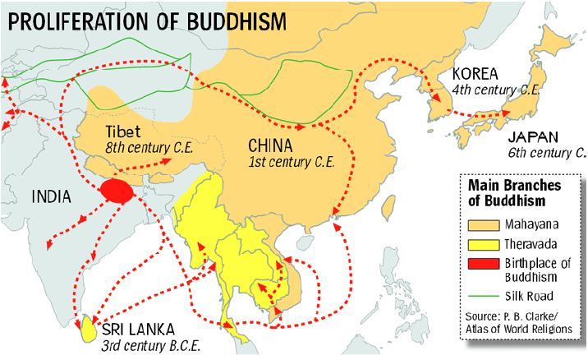
Basic belief: You can find peace from life’s troubles by praying (meditating) and doing good deeds
Shared ideas with Hinduism (ex. reincarnation) but rejected caste system
Spread to east and southern Asia through trade around 100AD.
No central holy book. Some holy books are:
Tipitaka, Sutras and the Tibetan Book of the Dead

Slide 11
11

Slide 12
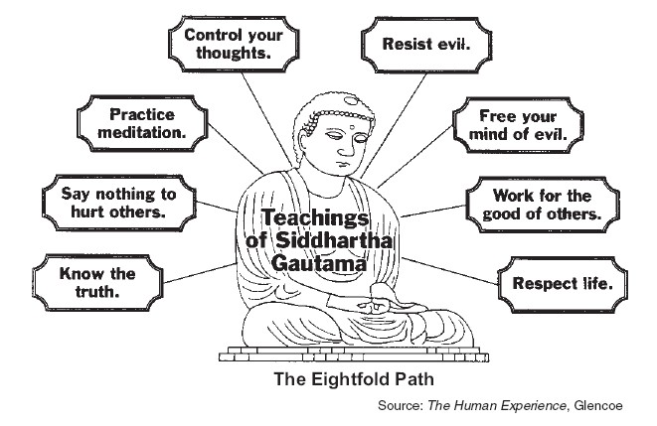
Buddhist Practice: 8 Fold Path

Slide 13
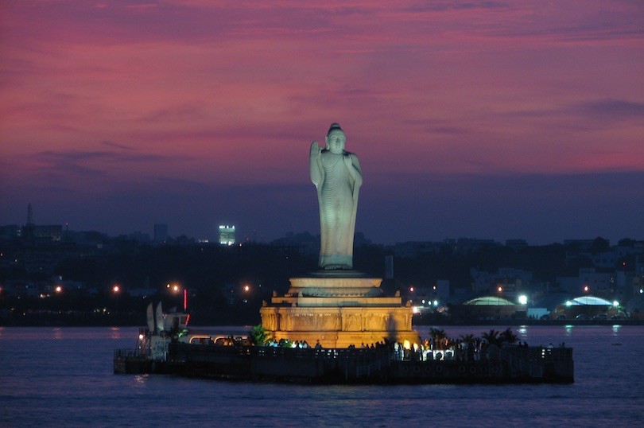
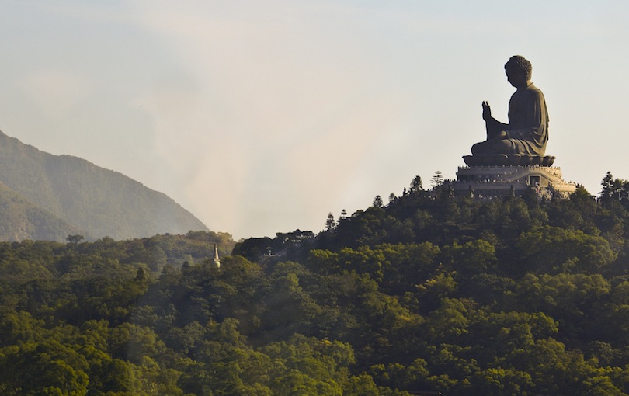
The Buddha statue situated at the center of an artificial lake in the city of Hyderabad is one of India’s most famous Buddha statues
Tian Tan Buddha referred to as
the “Big Buddha” is located on Lantau Island, in Hong Kong.

Slide 14
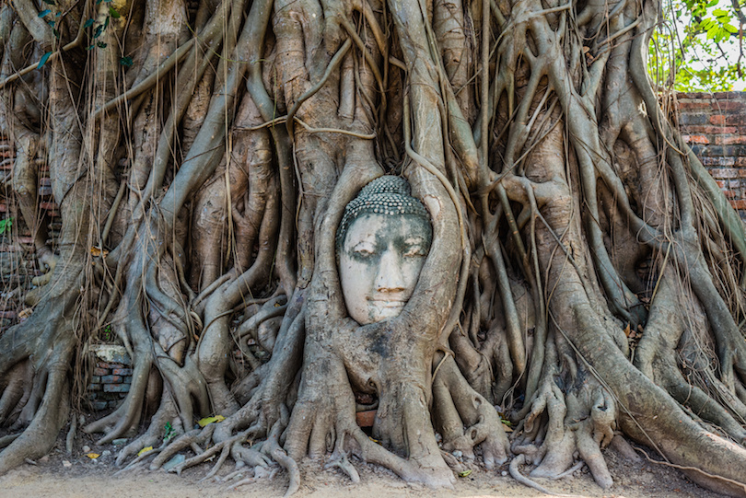
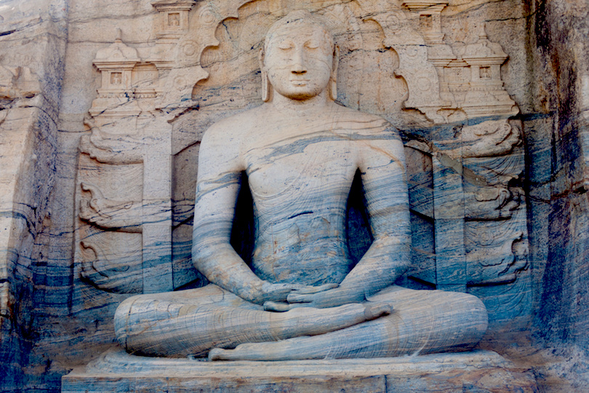
Thailand’s city of Ayutthaya is the location of one of the world’s most unusual Buddhist statues. Among the ruins of Wat Mahathat (The Temple of the Great Relic) is the remains of a sandstone statue of the Buddha whose body has been lost to the ages but whose head rests appropriately in the climbing roots and vines of a tree
Located in north central Sri Lanka, Polonnaruwa is the site of one of the most breathtaking of the world’s representations of the Buddha – the Gal Gal Viharaya. This massive rock temple was constructed by Parakramabahu the Great in the 12th century

Slide 15
8 fold path challenge
Each team will choose a part of the path.
Then, your team will create a charade (acting without talking) to try and get the rest of the class to guess what part of the path you are acting out

Slide 16
How religions spread
And now…

Slide 17
How do religions spread?
In your study guide write down 3 of the 4 ways that religions spread and give an example of each
(3 examples total).
You also may want to write down the definition of that way if you don't already know what the word means

Slide 18
Maps of religions spreading
Spread of Christianity map
Spread of Islam map
Religions like Buddhism spread through trade

Slide 19
Ways religion spread
CONQUEST C
(O)
MISSIONARY WORK M
MIGRATION M
(E)
TRADE T
YOUR TASK: You will each be given a sheet a paper with a word, diagram, or picture. Walk to the sign that correctly defines your sheet of paper.

Slide 20
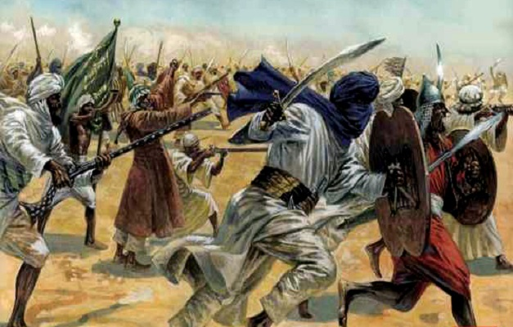
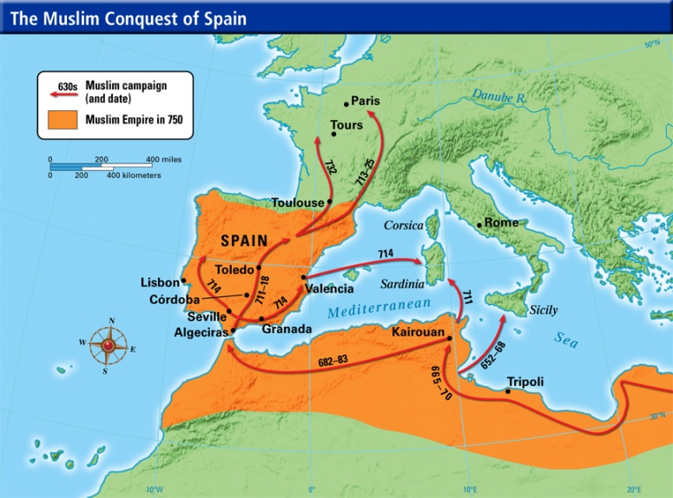
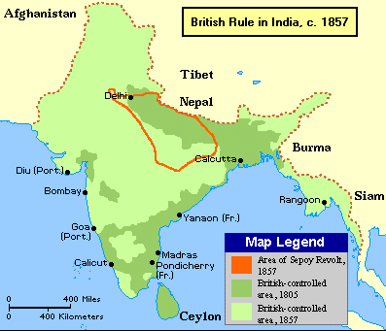
Conquest: to take over land outside of your country and make it part of your country
Spanish Explorers = Christianity to South America
Muslim Empires spreading through the middle east and even Europe (staring in the 600-700AD)
Britain colonizing India , USA, & S Africa brought Christianity with them

Slide 21
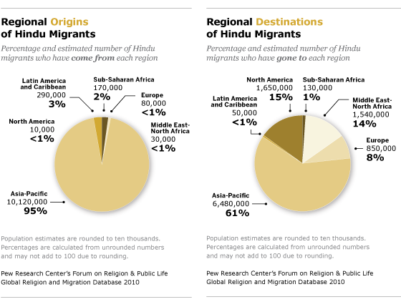
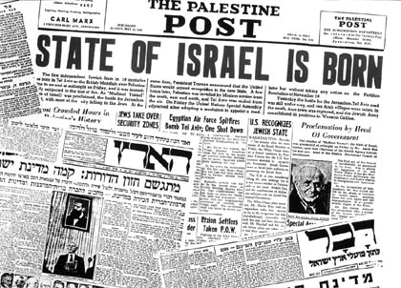
Migration: to move to a new place
Jews leave Israel because of persecution then return after WWII due to persecution in Europe
Pilgrims ( form of Christianity) leave England because of persecution to go to the “New World”
Syrian refugees bring Islam to Europe.

Slide 22
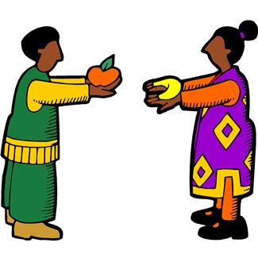
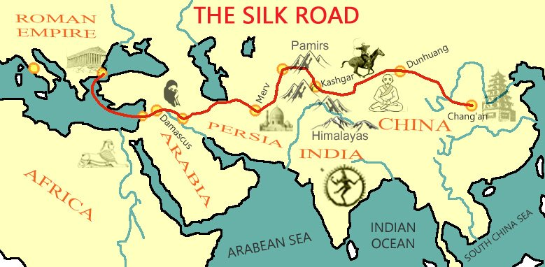
Trade:
to exchange ideas or items for something you need
Buddhism spreads from northern India through China, Thailand, Japan and beyond as a traders from India enter China for silk.
Exchange of goods and ideas along the Mediterranean Sea
Islam spreads from Middle East to places like Pakistan and Northern India in South West Asia through Arab trade

Slide 23
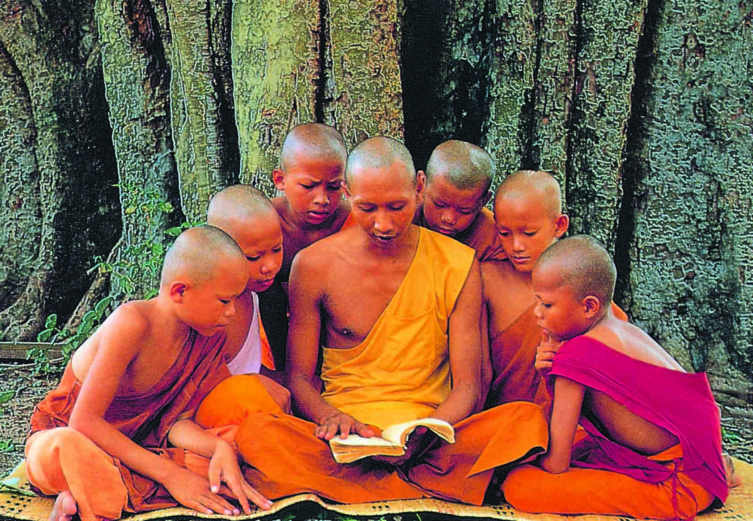
Missionary: people who go to a new place to spread their religion
People who go to a new place to spread their religion
Buddhist monks leaving India and bringing their religion to china and other Asian countries
Christian missionaries traveling through Europe
Missionaries traveling to South America during the Age of Exploration to bring Christianity
St. Patrick bringing Christianity to Ireland

Slide 24
Examples of how religion spreads
Trade:
Silk Road, Mediterranean trade, Arab Trade
This route passes through the middle east and India to china so Islam, Christianity and Buddhism start to spread
Mission Work:
Buddhist monks leaving India and bringing their religion to China and other Asian countries.
Christian missionaries traveling through Europe ( ex. St. Patrick, St. Paul)
Conquering/ Colonization:
Muslim Empires spreading from Middle East to other parts of Asia and even Europe ( starting in the 600-700AD). As they conquered new places, they brought their religion with them.
Britain colonizing India in the 1800s bringing Christianity with them.
Migration:
After WWII here was a large migration of countries who were recovering from war.
After WWII large migration from India to other western nations.
Jews leaving Israel because of persecution, then returning after WWII
Pilgrims ( form of Christianity) leaving England because of religious persecution, to go to the “New World”.( thank you Bobby Zajeck for this example)

Slide 25
Trade
Check out this website
The Silk Road was a trade route that ran from China through the Middle East. This spread religion.

Slide 26
Modern Influence
Ideas, practices and beliefs of Buddhism & Hinduism influence modern culture.

Slide 27
Non- violence
Idea of using peaceful ways/methods to bring about change.
Used first in India by Mahatma Gandhi who ended up freeing India from British rule/colonization.
Later used by Martin Luther King Jr. when during the American Civil Rights Movement.
Though each men were different religions (Hindu & Christian) BOTH religions shared idea of non violence and were able to influence one another.

Slide 28
Musical Artists heavily influenced by Hinduism and Buddhism
The Beatles:
Particularly George Harrison
Became interested in the teachings of Swami Vishnu-Devananda who started Sivandana Yoga
Went to India in 1966 to study, which would influence both sound and lyrics of the group
The Beastie Boys:
Particularly Adam Yauch
Traveled to Tibet several times and became interested in the religion through meeting various monks
Officially became Buddhist in 1996
Buddhist teachings would inspire lyrics and sound of groups music. They would also host Free Tibet Concerts to raise awareness.

Slide 29
Music
Lyrical content reflects influence of Hindu and Buddhist ideas
DIRECT INFLUENCES
“Tomorrow Never Knows”-The Beatles (1966) - Buddhist
(Lyrics directly from the Tibetan Book of the Dead)
“Bodhisattva Vow”- The Beastie Boys (1994) - Buddhist
(Monks chanting & lyrics directly reference Buddhist teachings)
“Within You and Without You”- The Beatles (1967) - Hinduism
(Lyrics based on Hindu teachings)
“Shanti/ Ashtangi”- Madonna- Hinduism (Vedic chanting)
INDIRECT INFLUENCES
“Karma”- Alicia Keys (2004)
“What goes around Comes around”- Justin Timberlake (2006)
Sound of music reflects influence as well
“Paint it Black”- The Rolling Stones (1966)
“Jimmy” - M.I.A. (2007)
“Wherever I May Roam”- Metallica (1991)
“Come and Get It”- Selena Gomez (2013)

Slide 30
Yoga
Originally only practiced by priests now used as exercise.
Check out how many yoga studios are near Chesterland alone!
As of 2012: 20.4 million Americans practice yoga, compared to 15.8 million from the previous 2008 study *a 29% increase
In addition, practitioners spend $10.3 billion a year on yoga classes and products, including equipment, clothing, vacations, & media.
Statistics taken from: http://www.yogajournal.com/press/yoga_in_america

